Slide 1
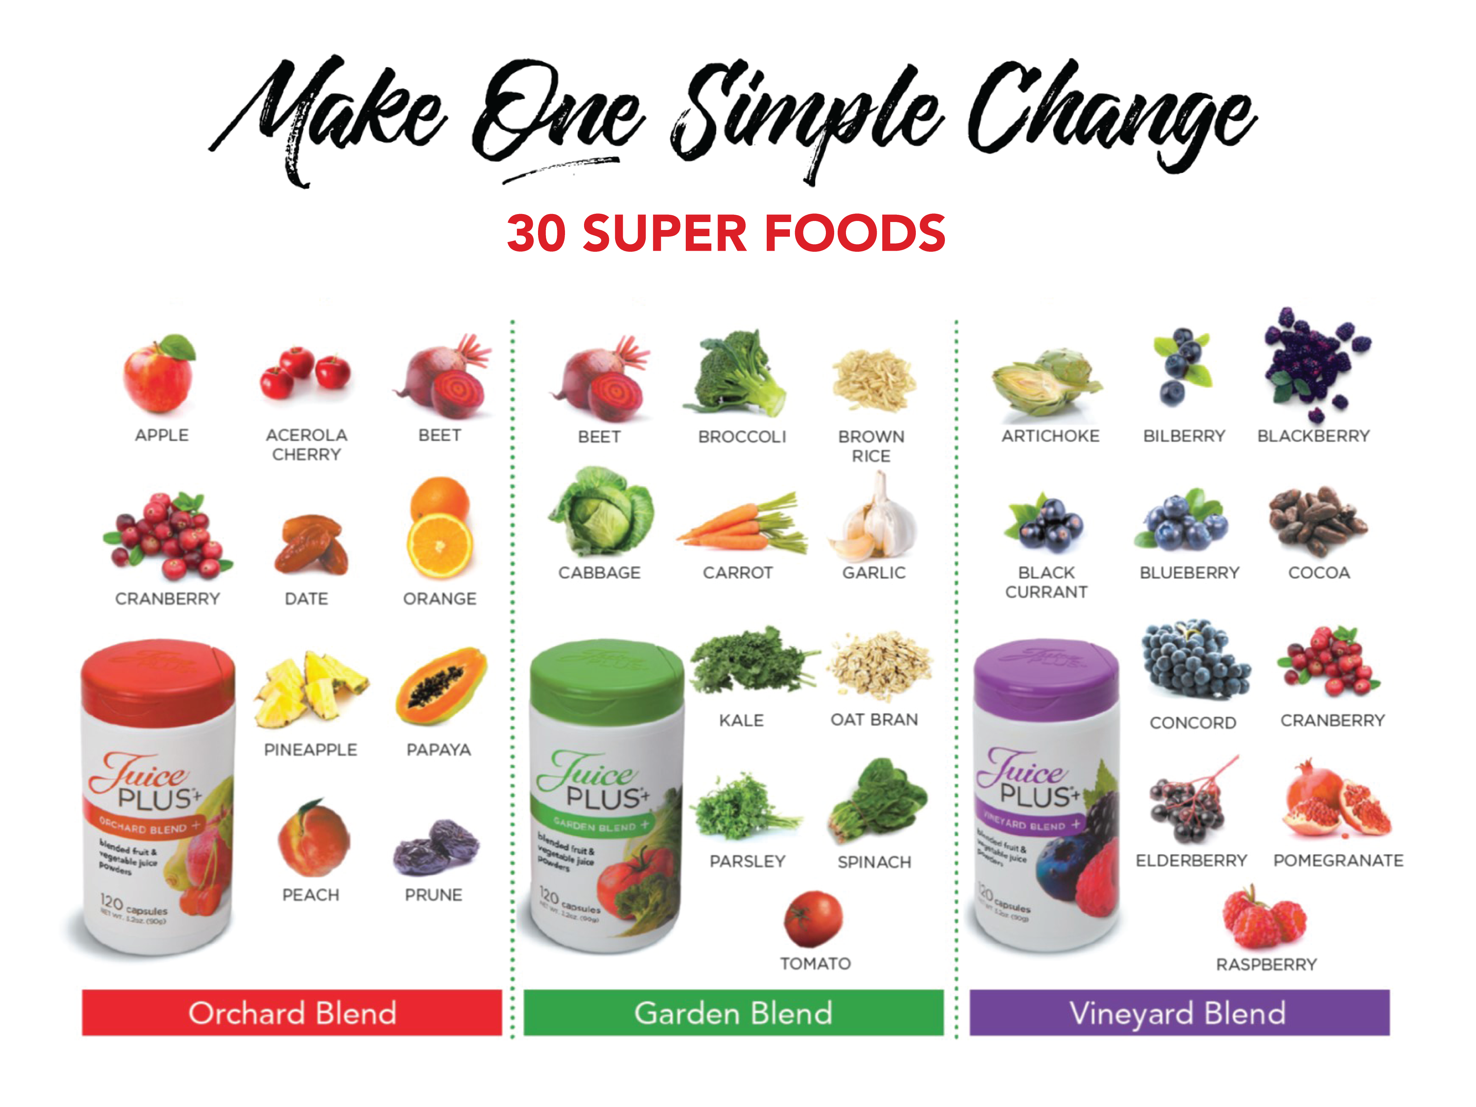

Notes:
SCRIPT IDEA: Hello everyone! My name is _______ We’re so excited you’re joining us to learn how one simple change can add up to huge and meaningful results in your health. I didn’t always have thriving health but I do today! I’m so excited to share this information with you. It has changed everything for me.

Slide 2
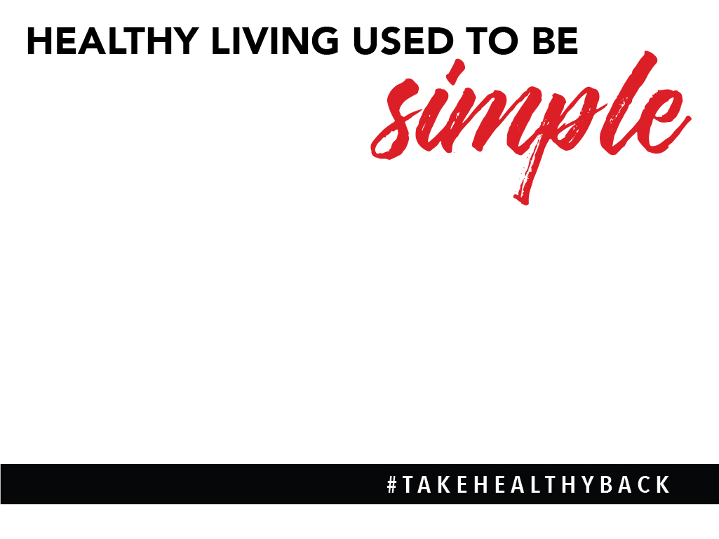


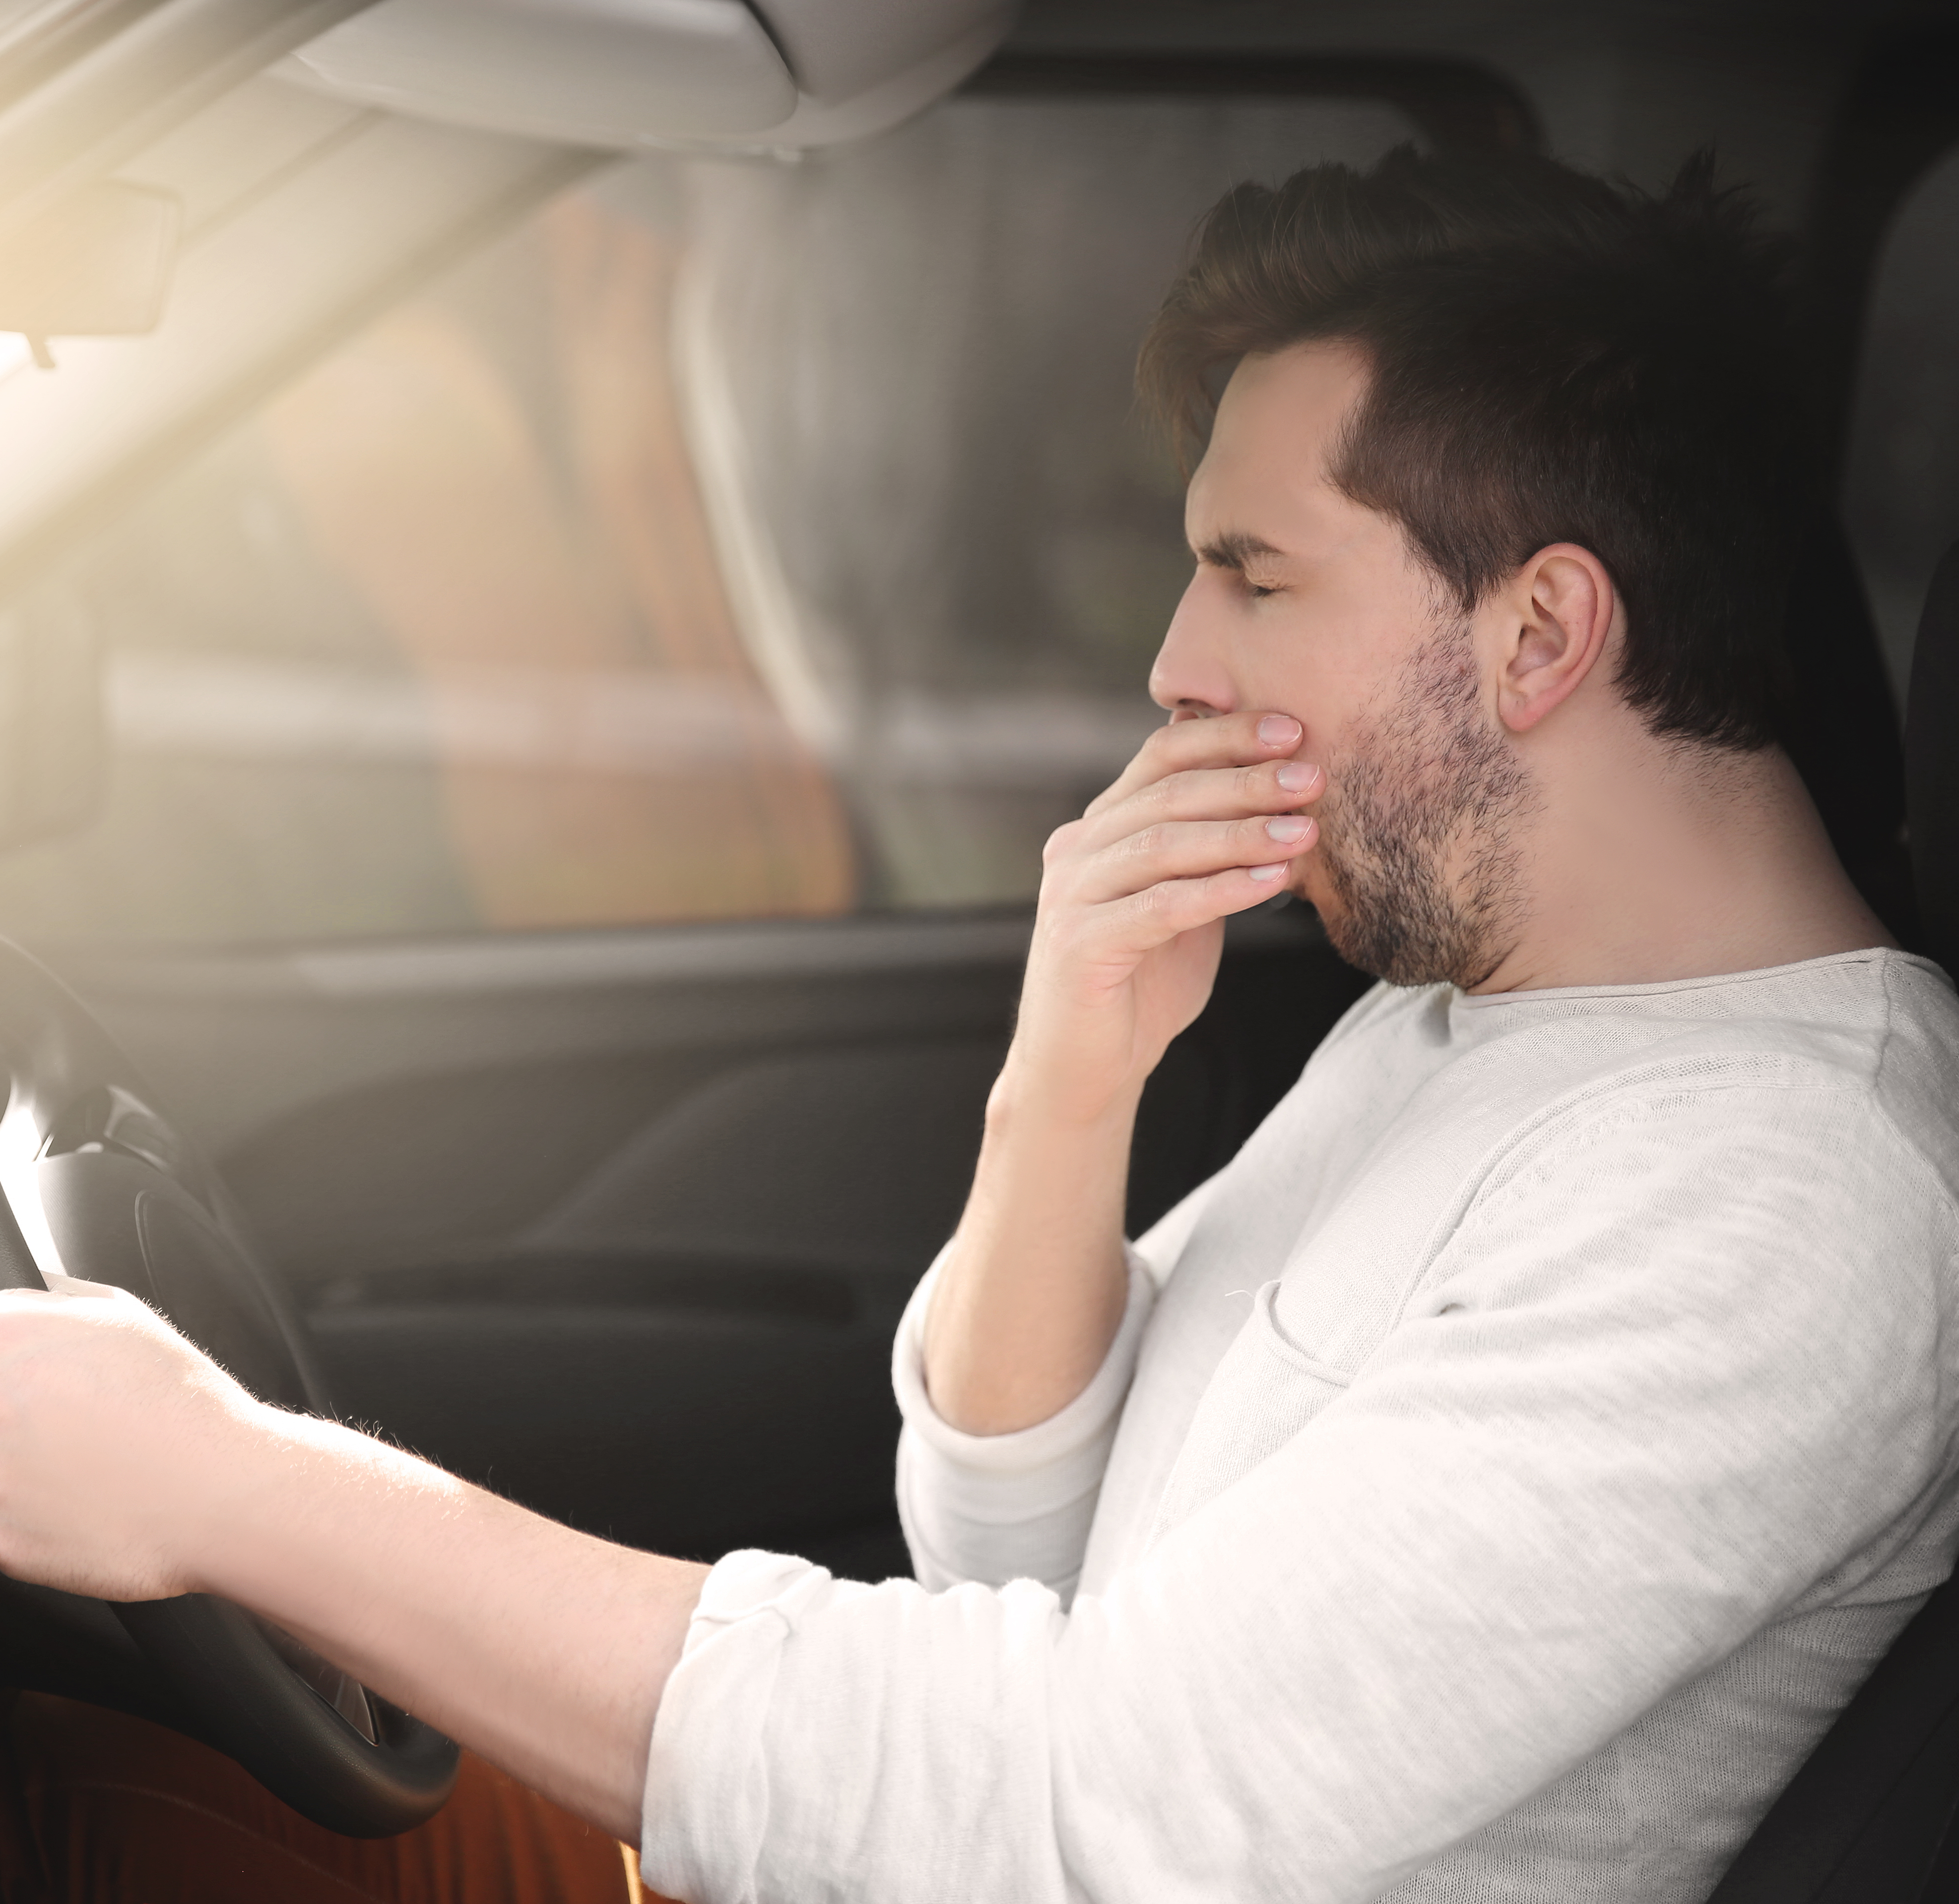

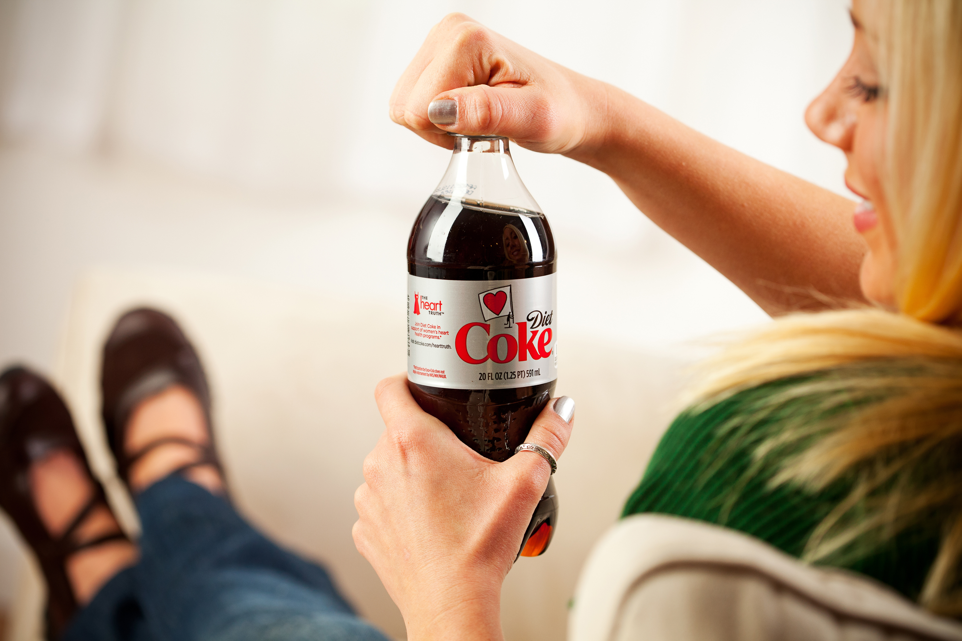

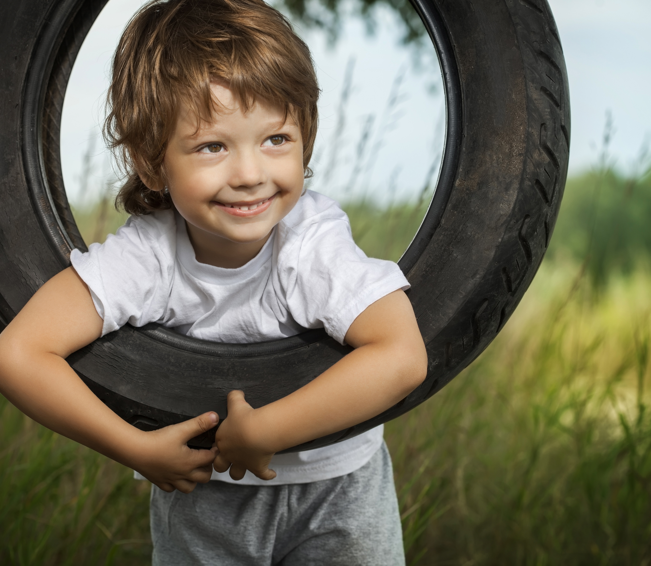
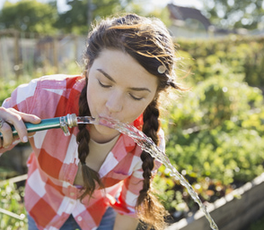

Notes:
SCRIPT IDEA: Healthy used to be simple. It wasn't the latest super food or the new diet craze. Healthy was fresh vegetables from grandma's garden. Kids played outside until it was dark, drank water from a hose, and at the end of the day we were tired and went to sleep.
Today looks very different. Family dinners are replaced with fast food. Neighborhood games outside are replaced with games online and smart phone socializing. Sugary sodas and desserts used to be birthday party foods, but are now everyday treats. And people turn to energy drinks because they don’t have the energy to get through their day.

Slide 3
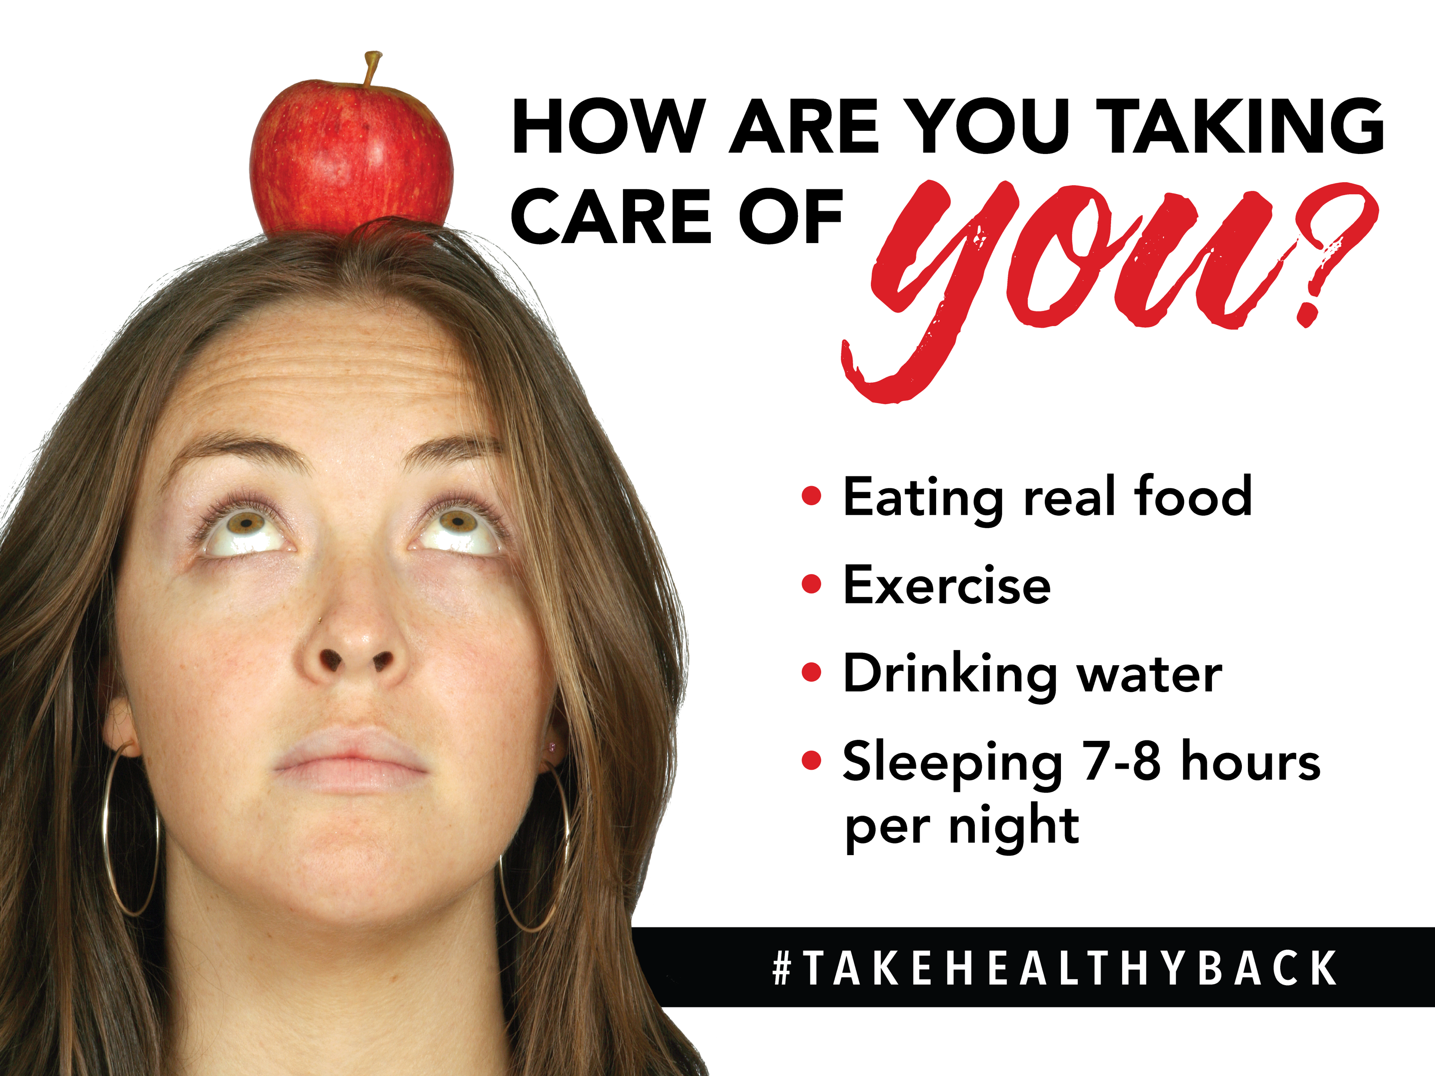

Notes:
SCRIPT IDEA:
So how are you taking care of yourself? I think we can all agree that our health is made up of these 4 core things…
How are you doing with…
Eating Real Food, not something from a box or package
Exercise…Find something you love and DO IT!
Water? We should strive for ½ of our body weight in ounces per day
Getting enough Sleep and Reducing Stress…your body does all kinds of things while you are sleeping…its detoxifies, repairs, and your hormones are able to do their thing. Society today is sleep deprived…almost like its a badge of honor. We need proper sleep to be healthy.
Of all the lifestyle changes you could make, the one that is most proven to make the biggest impact on your health is to consume a diet rich in fruits and vegetables. Over 4,000 studies show that making that one simple change makes a profound impact on our health.

Slide 4

Notes:
SCRIPT IDEA: There are TWO startling trends in our world today!

Slide 5
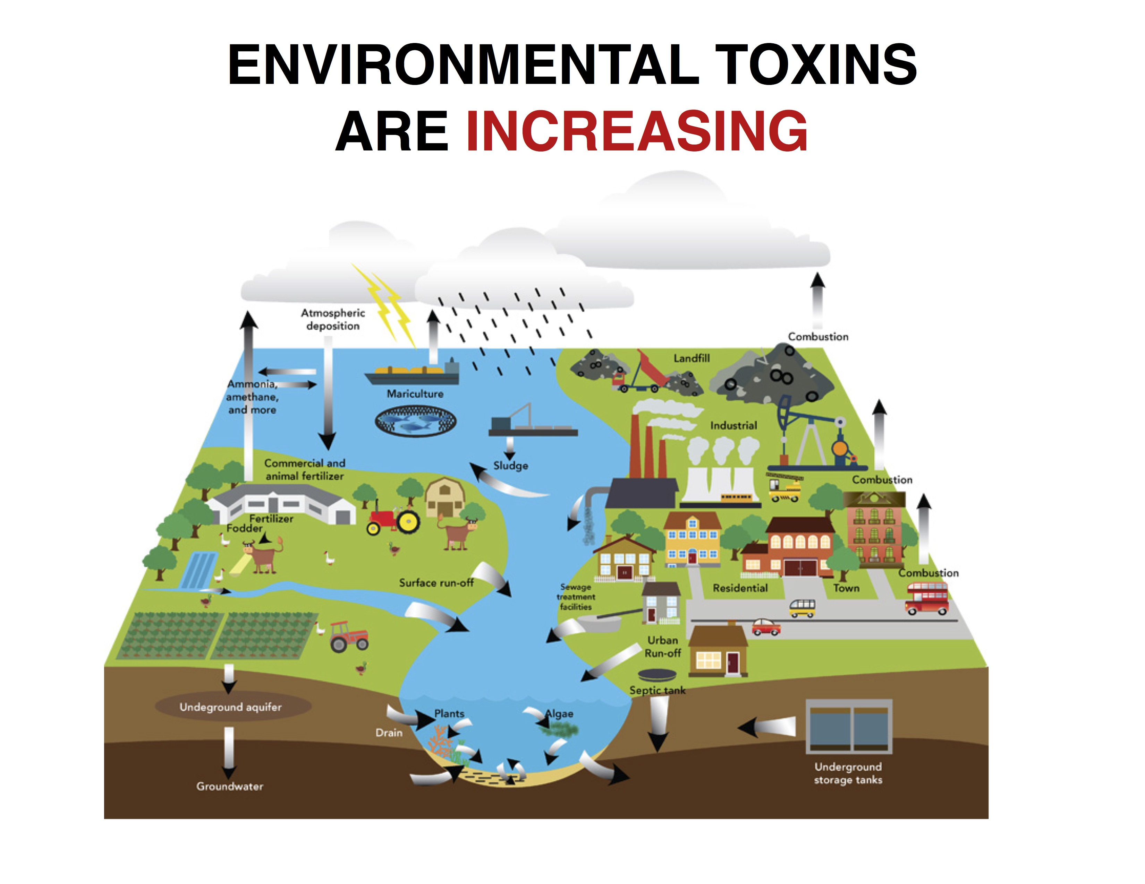
Notes:
SCRIPT IDEA: Environmental Toxins are increasing

Slide 6
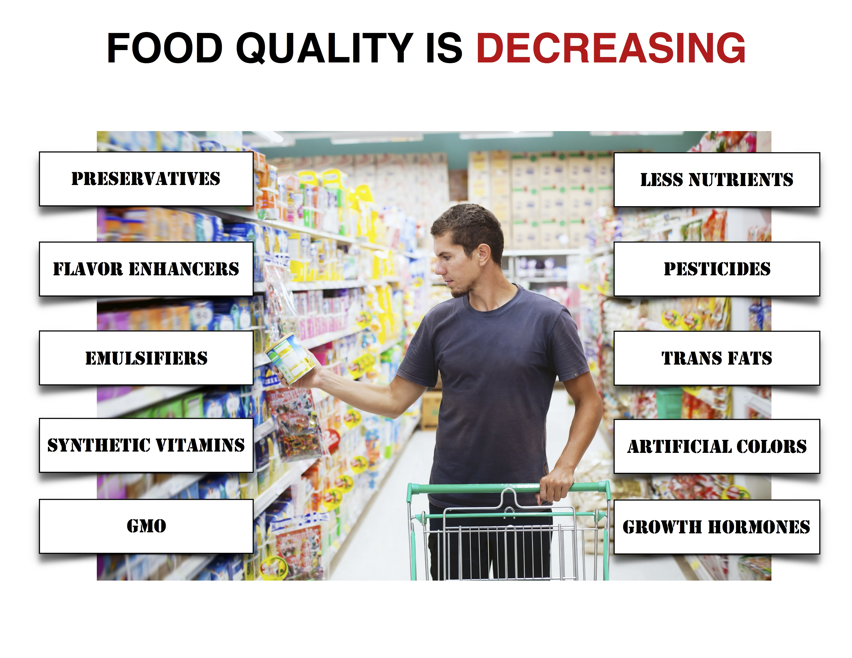
Notes:
SCRIPT IDEA: AND OUR FOOD QUALITY IS DECREASING WHICH IS causing THE PERFECT STORM IN OUR BODIES.
(Optional discussion of processed food– Our food quality is decreasing with many additives and preservatives that help the shelf life but not our bodies. Etc. )

Slide 7
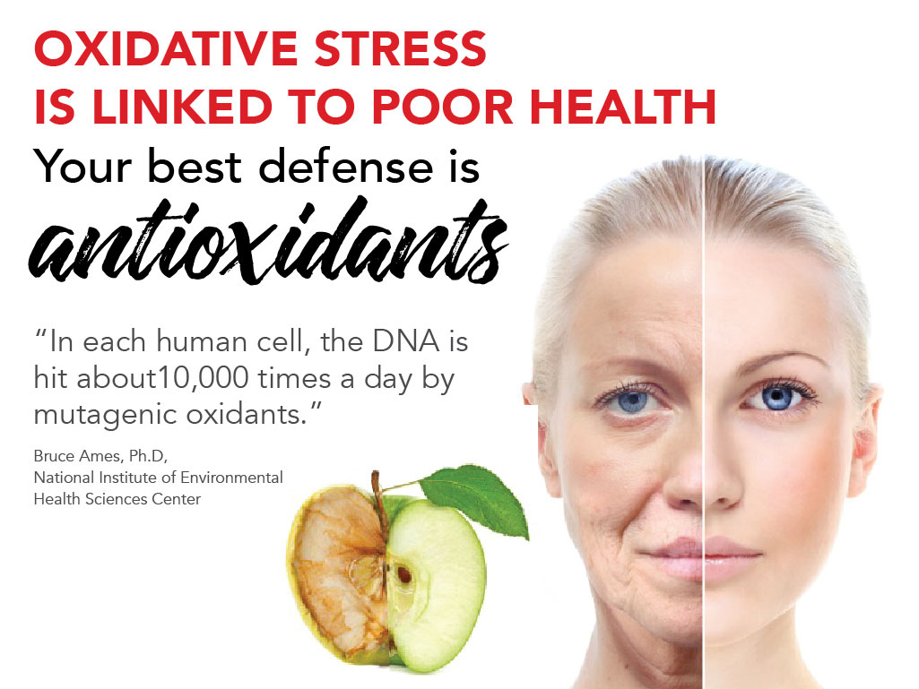

Notes:
SCRIPT IDEA: Increased environmental toxins and decreased quality of food is causing Oxidative Stress in our bodies everyday. But there are other causes as well: smoking, exercise, stress, medications, flying in an airplane and even pregnancy. This is important to understand because oxidation causes aging and disease. Wrinkles are an example of oxidative stress happening in our skin cells.
Another illustration of oxidative stress is the APPLE – if you cut an apple in half and you leave it out. What happens? (Right, it turns brown, it ages) So if you squeeze lemon juice on it (which is the ANTIOXIDANT), it slows down the aging process.

Slide 8
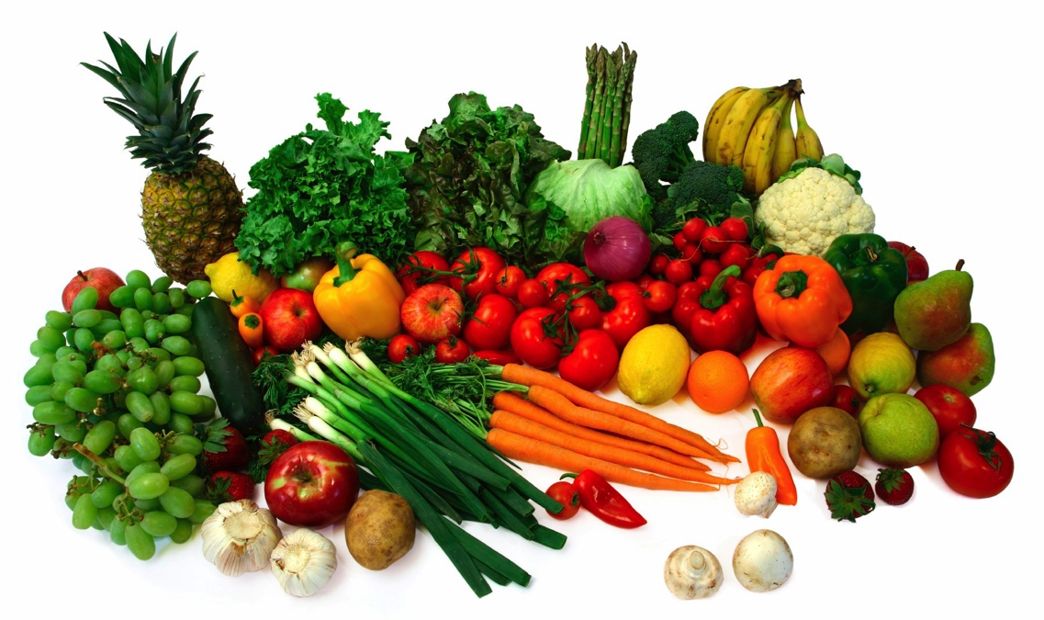
Notes:
SCRIPT IDEA: Just like that lemon helps to lessen the oxidative stress on the apple, ANTIOXIDANTS from fruits and vegetables neutralize that harmful oxidative stress and they are our best defense. They shield and protect us!

Slide 9
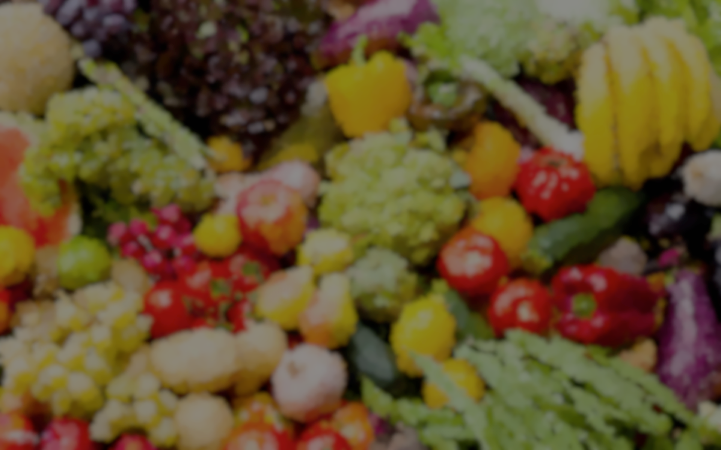
“The news isn’t that fruits and vegetables
are good for you. It’s that they are so
good for you they could save your life.”
Time Magazine, 2003
Notes:
Time Magazine says “The news isn’t that fruits and vegetables are good for you. It’s that they are so good for you they could save your life.” So we need to eat 7-13 servings of fruits and vegetables every day. But almost no one does - and certainly not the variety or the consistency we need.

Slide 10
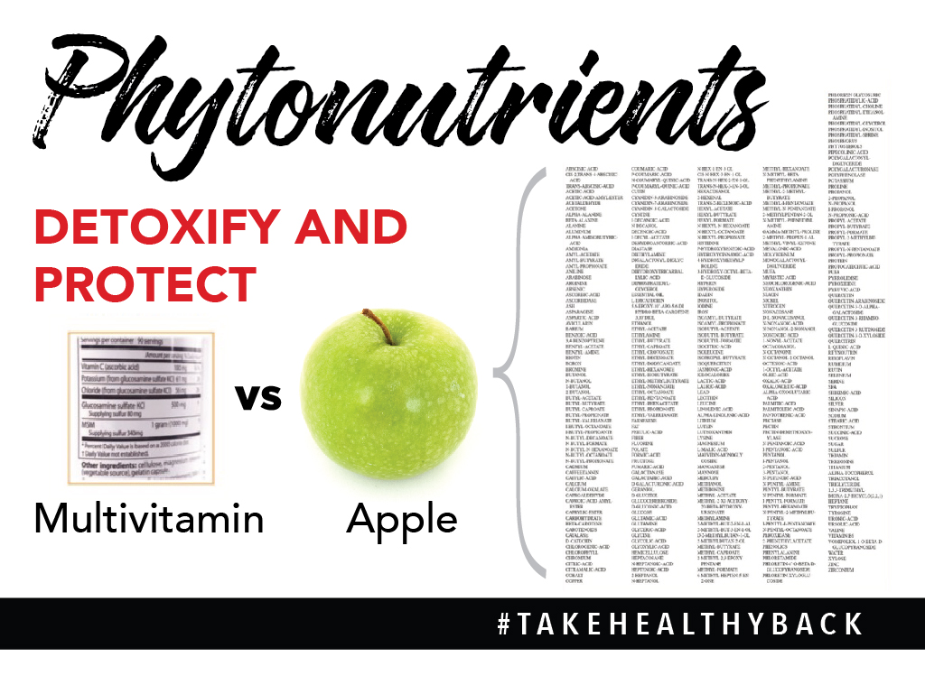
Notes:
SCRIPT IDEA: Most people know they’re not eating enough fruits and vegetables everyday, so 70% of Americans turn to vitamin supplements. But let’s talk about the difference between vitamins and whole food. A vitamin has 35-50 isolated nutrients in it, whereas an apple has 10,000 nutrients in it! Each fruit or vegetable has that many and they work together to protect our bodies. There’s no comparison – vitamins barely scratch the surface as far as potential or effectiveness! Science is telling us over and over to get our nutrients from whole food instead of from isolated nutrients, and that isolated nutrients may do more harm than good!
Most of our vitamins and minerals should come from plant sources, specifically fruits and vegetables!

Slide 11

Notes:
SCRIPT IDEA: It is important to eat as many fruits and vegetables as you can daily – even beyond the minimum recommendation . Maybe you are someone who DOES eat a lot of fruits and vegetables. This is great but it’s important to know that our fruits and vegetables today are picked too early, transported thousands of miles so they are not as nutritionally dense. So that’s why we need at least 7 - 13 servings per day. A serving is the size of your fist. If you’re a serious athlete you may need to eat as many as 16-18 servings per day. WOW!
So I am really thankful I learned about a simple way to add more fruits and vegetables to my diet.

Slide 12
STORIES
Notes:
(Insert photos of story tellers)
SHARE YOUR JP+ STORY AND HAVE A GUEST SHARE THEIRS (i.e. New Rep, Existing Rep, Raving Fan Customer)
How to write your product story:
_______ years/months/days ago I was ____________ (describe BEFORE Juice Plus+). Then I learned about a simple change I could make to flood my body with 30 fruits and vegetables every day. I can’t believe the difference it has made in my health. Now I’m ______________ (describe AFTER Juice Plus+) I’m so thankful I learned about Juice Plus+!

Slide 13
30 WHOLE FOODS
Notes:
SCRIPT IDEA: So the ONE SIMPLE CHANGE we made is called Juice Plus+. Juice Plus+ is a way to add 30 raw, vine ripened fruits and vegetables. Vine-ripening is so important because over half of the nutrients develop in the last 2-3 days of the ripening process. After the produce is picked, they are juiced and dried and put into a capsule or chewable. They even juice the peels, leaves and seeds. It’s like getting the rainbow – a huge variety of fresh produce everyday! It’s not a substitute for the real thing – it helps us bridge the gap.
(Optional: SHOW CAPSULES IN ONE HAND AND CHEWABLES IN THE OTHER)

Slide 14
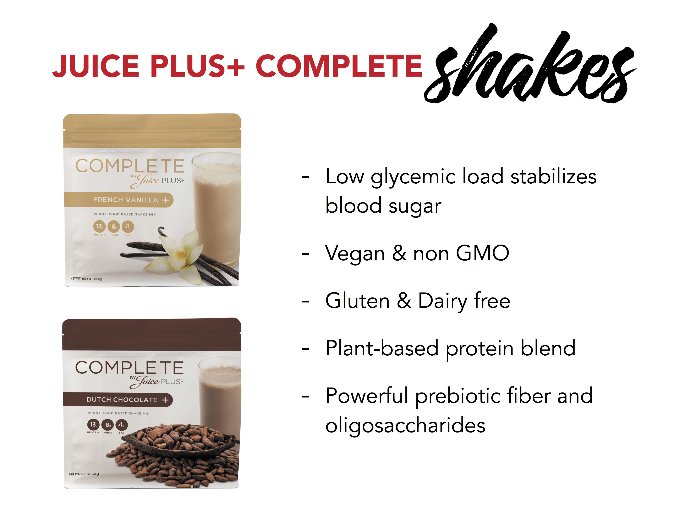
Notes:
SCRIPT IDEA: Let’s talk about the Juice Plus+ shakes. The Chocolate and Vanilla Complete is vegan, gluten-free, whole-food protein, fiber, amino acids, and fruits and vegetables in a shake. It’s great for any meal, post-workout recovery, or a mid-afternoon snack. The Complete also comes in snack bars. This is the MACROnutrition and it is a beautiful compliment to the MICROnutrition of the capsules or chewables. Macronutrients are like the gas in your car, micronutrients are like the oil. You have to have both!
(Share your own personal experience with the shake and how you make it)
Example: When I started drinking this for breakfast I noticed that I wasn’t starving at 10:00 in the morning any more and again at 3 in the afternoon. I started realizing that this shake was affecting my blood sugar in a positive way.
Example: I’ve had digestive issues for years and that started to change when I drank the shake. Then I heard a doctor speak about this shake and he said the prebiotic fiber was like a broom sweeping through the intestinal track.
And the JP Complete is delicious!” I CRAVE IT EVERYDAY!

Slide 15
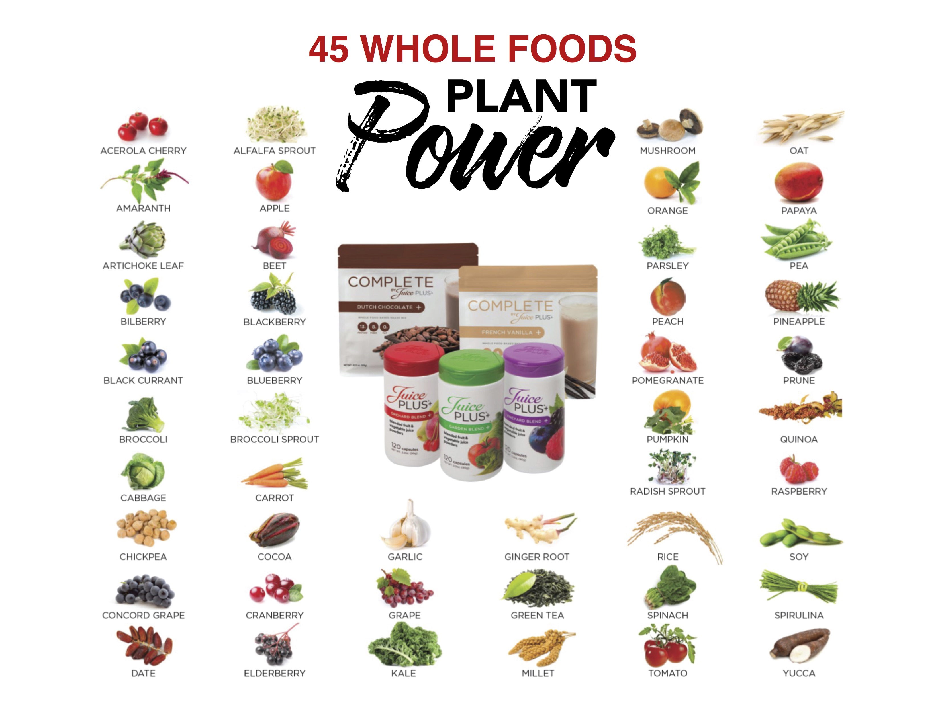
Notes:
SCRIPT IDEA: When you add the JP+ Complete shake to the capsules you are now getting the nutrition from 45 whole foods everyday.

Slide 16
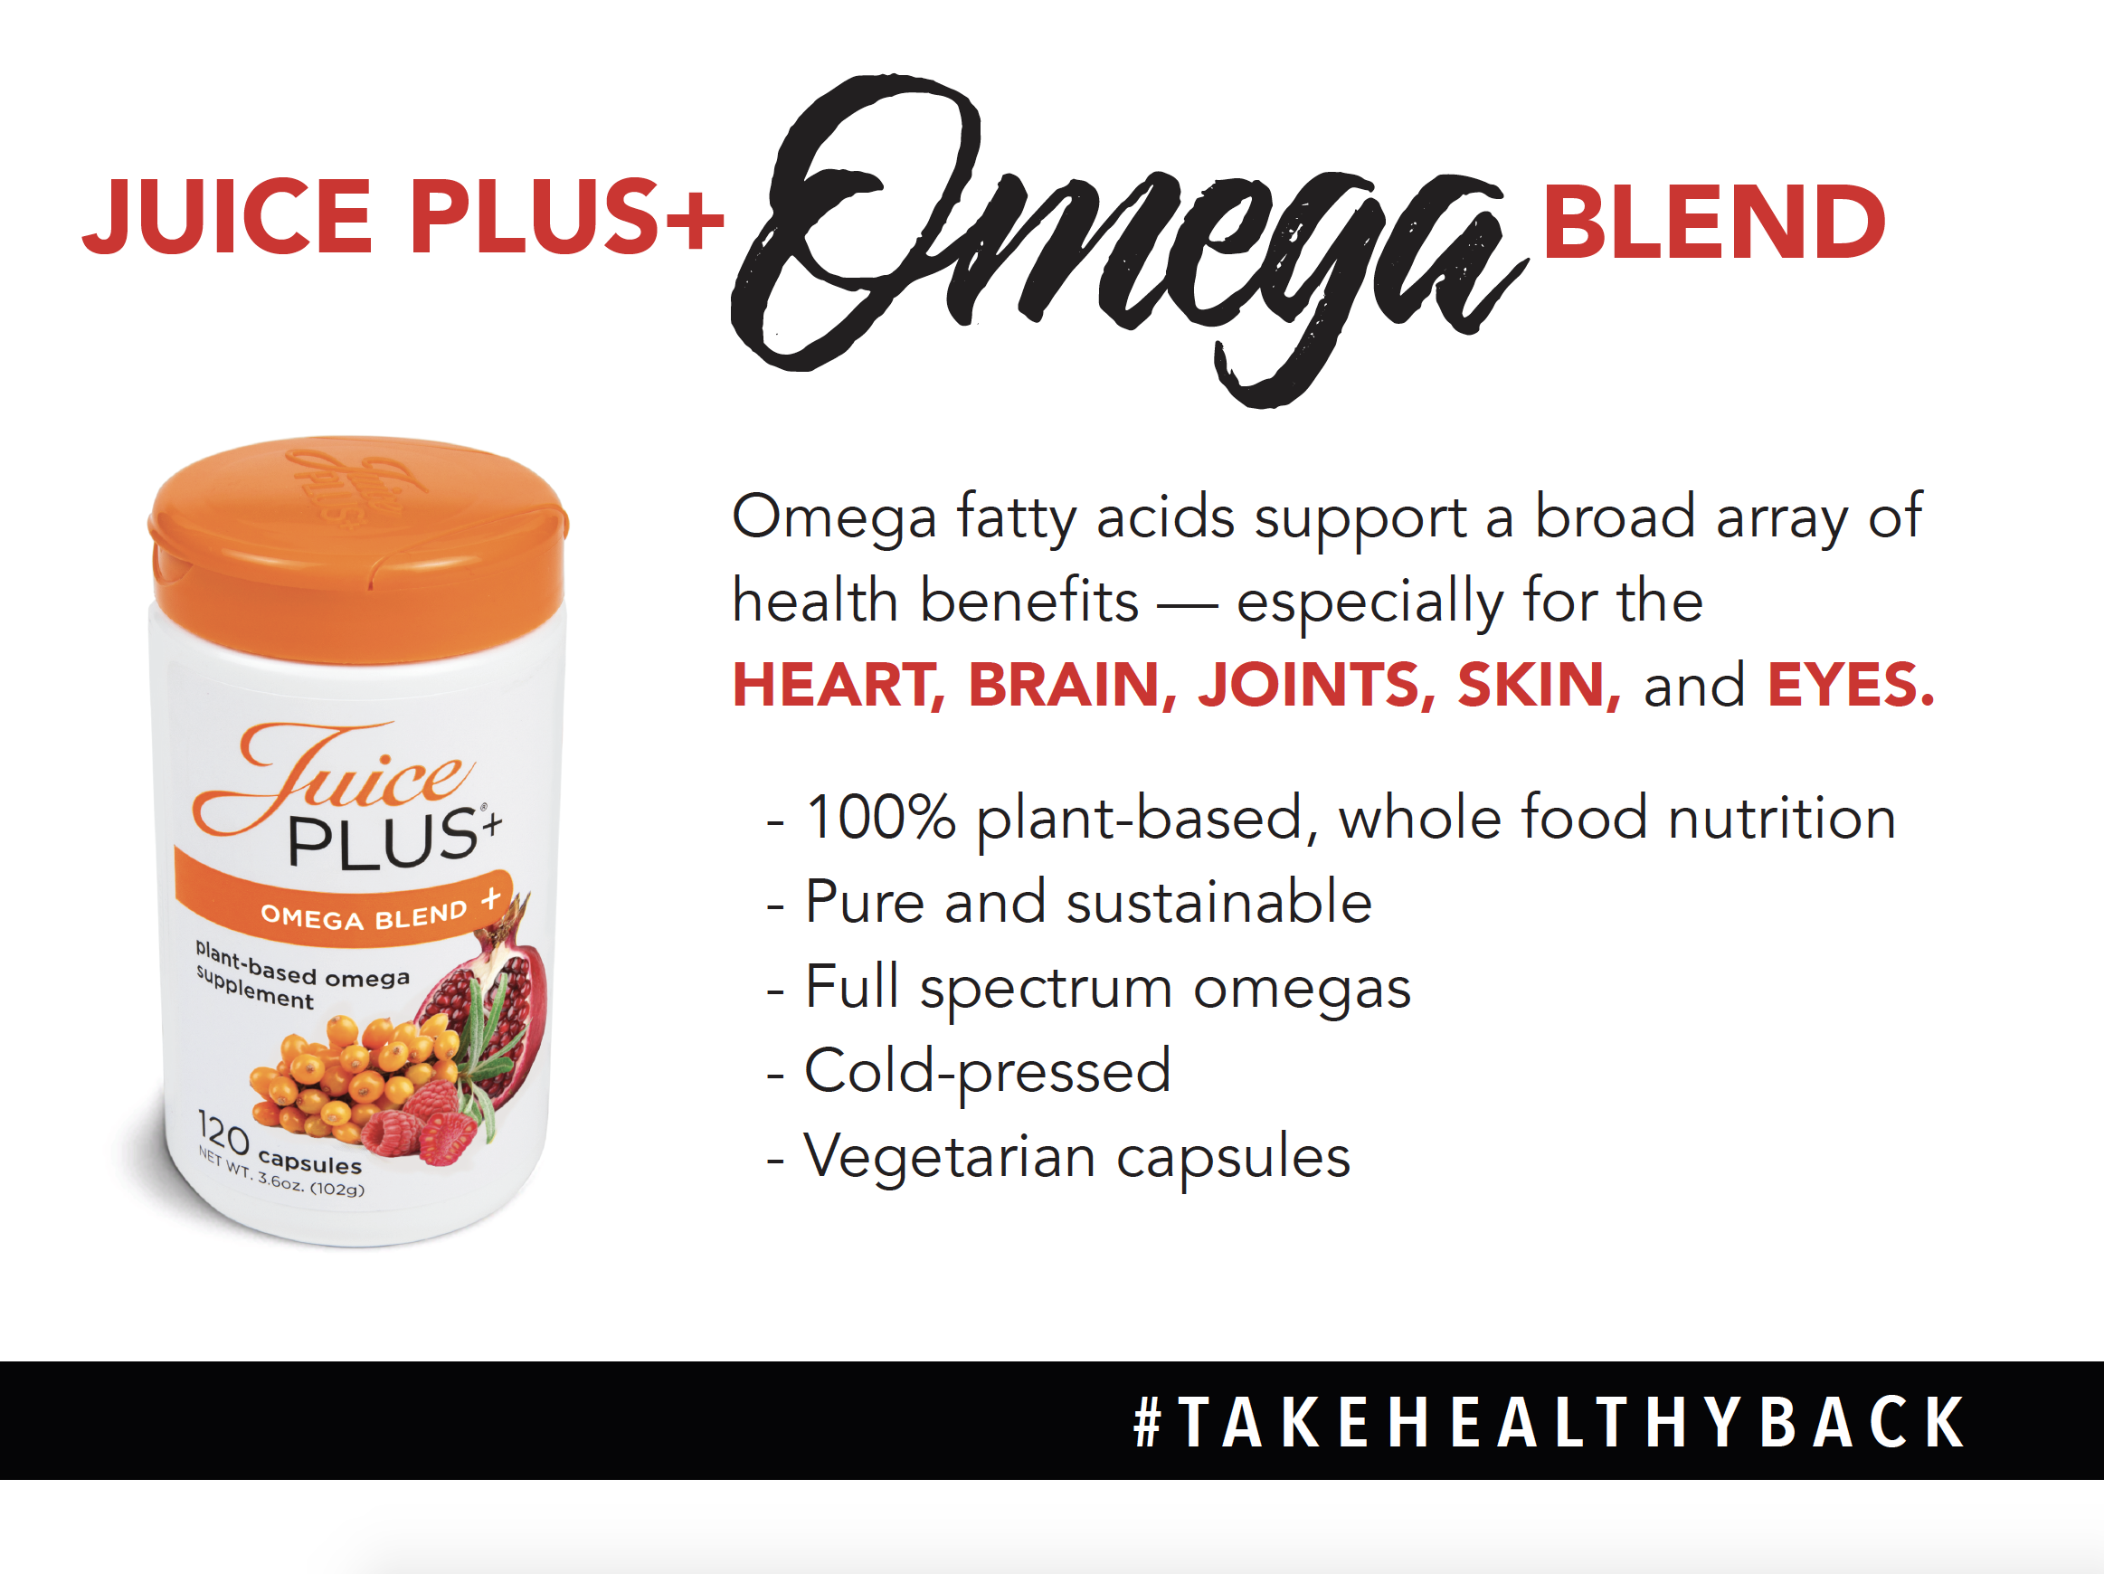
Notes:
SCRIPT IDEA: 10 years ago the Juice Plus Company sent out a survey asking what else customers are taking in addition to Juice Plus and the answer was Omegas. So the company found a way to create an ALL PLANT based blend of Omega 3, 5, 6, 7 and 9 fatty acids. They cut out the middle “fish” and went straight to the algae and plants to get the omegas. The Juice Plus+® Omega Blend is the first to use cold-fusion technology so the oils aren’t exposed to heat.

Slide 17

Notes:
SCRIPT IDEA: There are a lot of nutritional products out there but Juice Plus is unique in 3 ways:
1. It’s food, not a vitamin. (show food label) This is a nutrition label, not a vitamin supplement label. It’s the same label you’ll see on a bag of frozen broccoli in the grocery store. The government considers this food.
2. NSF, a private company certifies JP+ products to be sure that what is on the label is in the product and they stringently test for pesticides, mold, bacteria, stimulants. etc. There is no warning label on JP+ —safe for people of all ages, pregnant & nursing mothers, children, elderly, and even professional athletes.
3. And JP+ is THE most thoroughly researched nutritional product in the world.

Slide 18
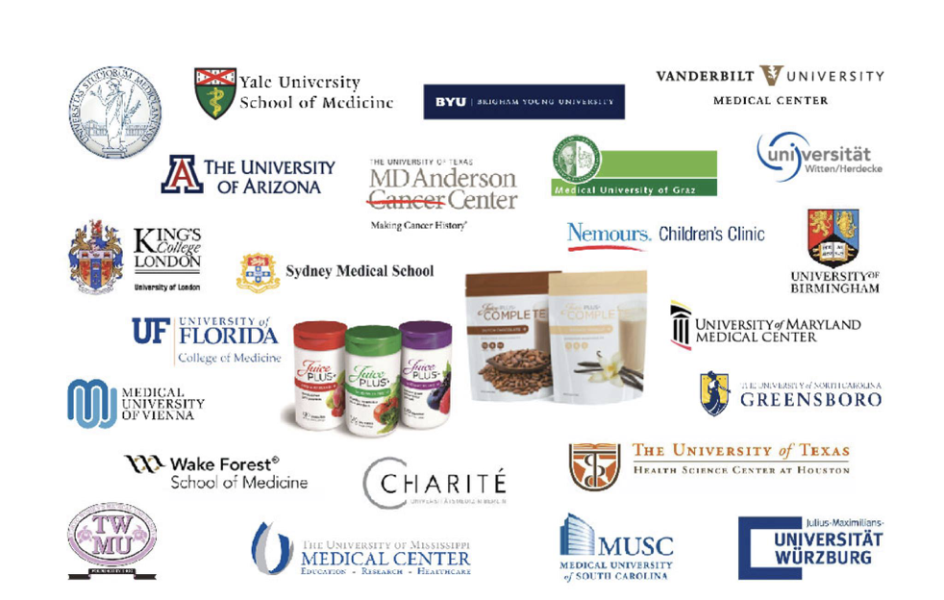
The Most Researched Nutritional
Product in the World.
Notes:
SCRIPT IDEA: JP is set apart from all other nutritional products because of the original, clinical research that has taken place all over the world for over 20 years. Well known research institutions have studied what happens in people’s bodies when they consume Juice Plus+. These are gold standard – double blind, placebo controlled, randomized so very credible research that has been published in peer reviewed medical journals.
(Point out some of your own favorite universities)
Example: I’ve heard about MD Anderson from people for years and about the credibility of that hospital. How impressive that Juice Plus has a study that was done there!

Slide 19
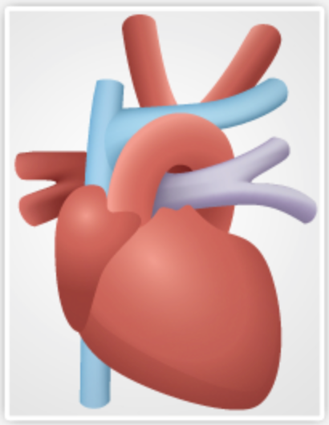
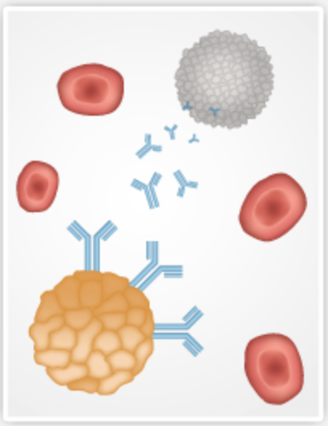
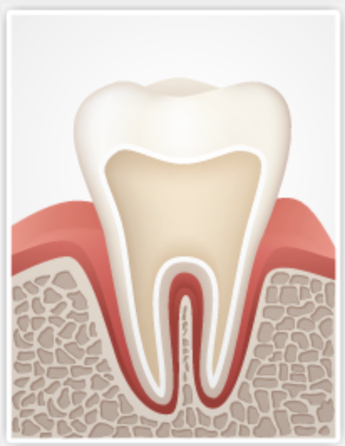
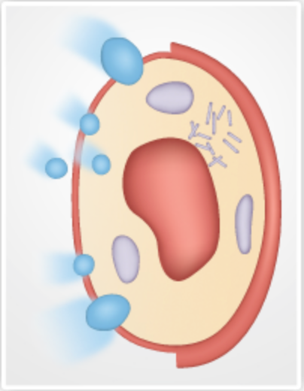


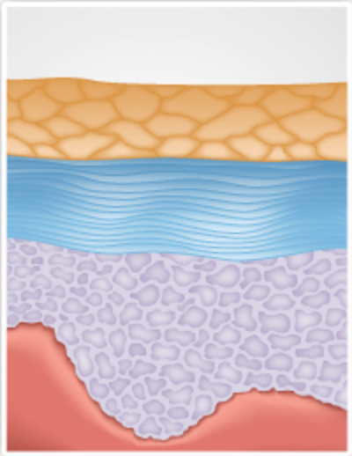
Improves
Cardiovascular
Wellness
Supports
The Immune
System
Improves
Gum
Tissue
Reduces
Oxidative
Stress
Reduces
Inflammation
Protects
DNA
Healthier
Skin
+ Insulin Resistance
+ Abdominal Fat Mass
+ Quality of Life
+ Lung Health
Notes:
SCRIPT IDEA: These are some of the results that we have seen from the JP+ research. (Read the categories)
(Share your favorite study and why)
Example: As an athlete, I loved learning that Juice Plus has been published in the official journal of the American College of Sports Medicine. One of these studies showed that the oxidative stress was reduced in elite athletes and that JP strengthened the immune system too! Very exciting for me because I exercise so much!

Slide 20


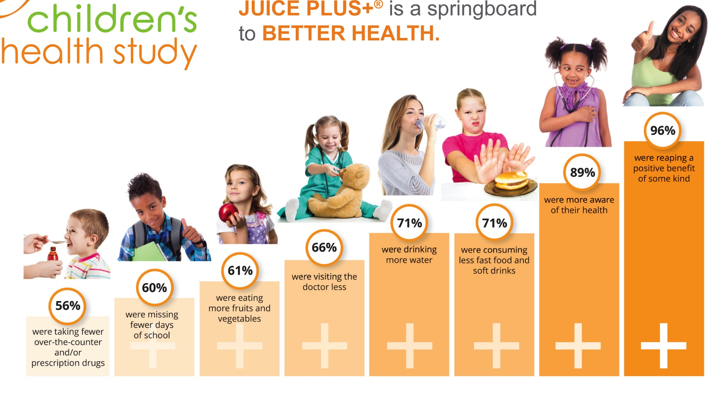
Notes:
SCRIPT IDEA: Children can receive their JP+ FREE for up to 4 years. They must be between the ages of 4 years old through college age. If mom buys JP, she can sponsor a child to receive it for free. Dad or another adult can also sponsor a child. Parents are asked to fill out a quick survey about what effect JP has had on the health of their family. We’ve had almost 1 million children participate in the CHS and look at the wonderful results…
Point out your favorite result(s)
Example: My favorite is that 61% are craving more fruits and vegetables! My kids are actually asking for salads now which is amazing!

Slide 21
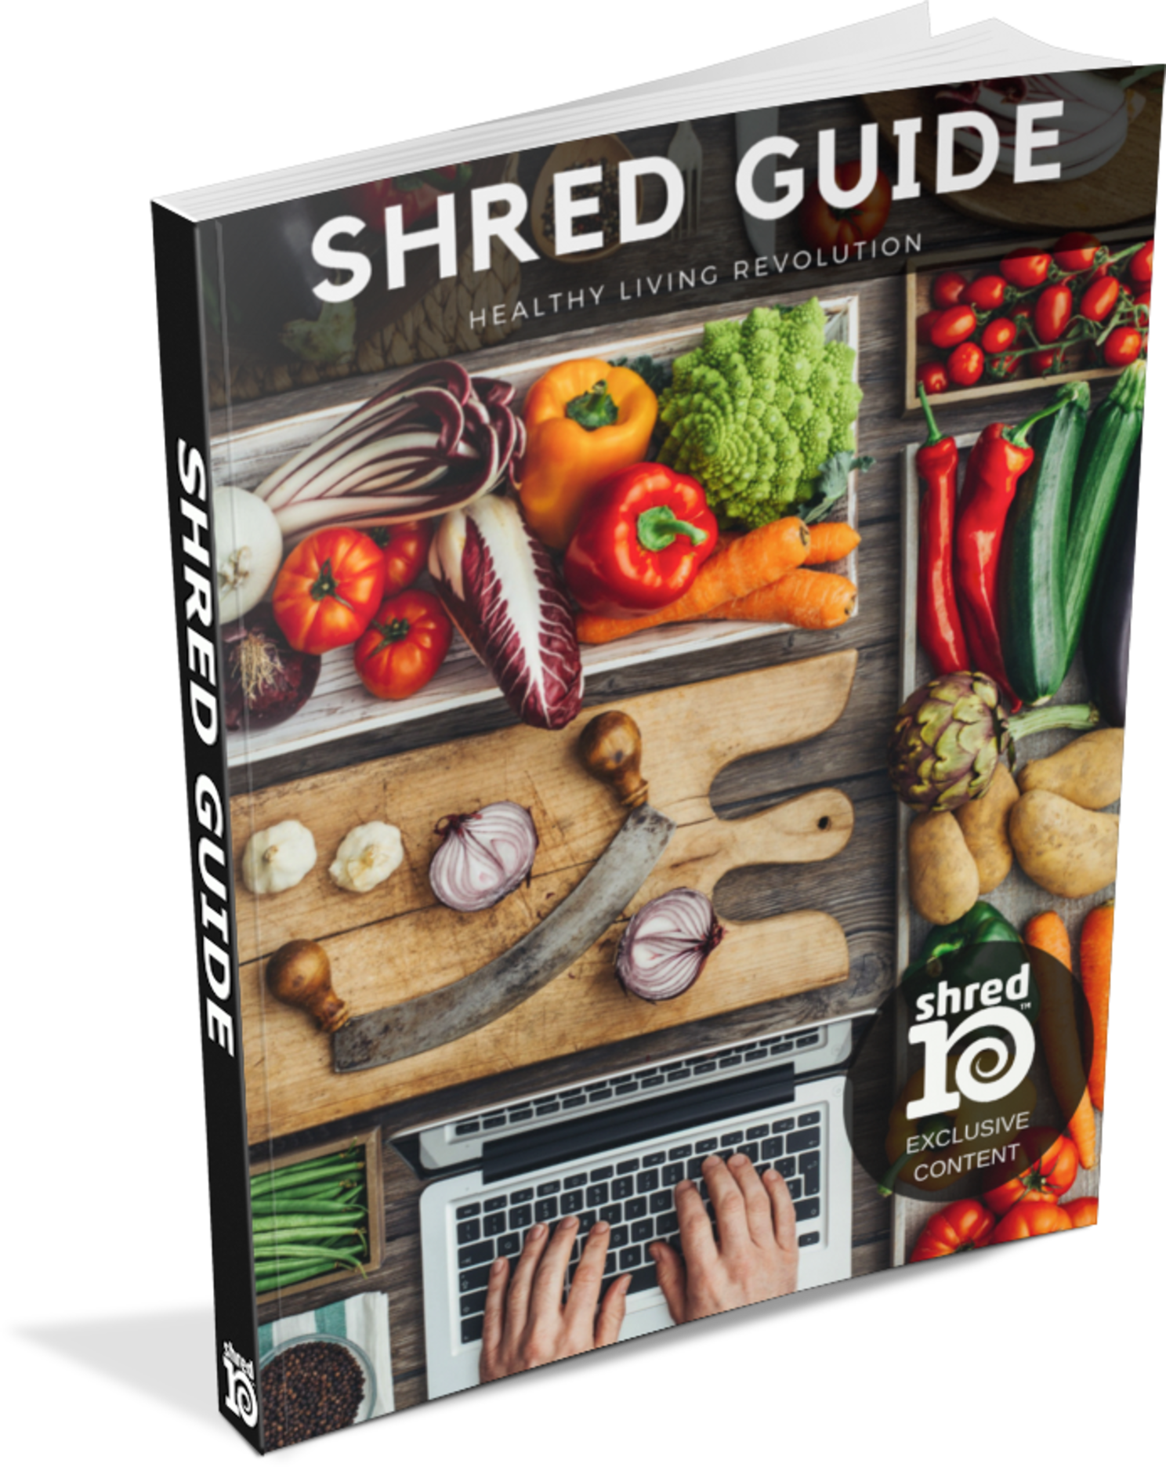

Notes:
SCRIPT IDEA: Juice Plus+ is the most proven and simplest change you can make and people are experiencing amazing benefits with JUST TAKING JUICE PLUS!
If you’re also looking for a set of lifestyle guidelines we have a program called the Shred10™.

Slide 22
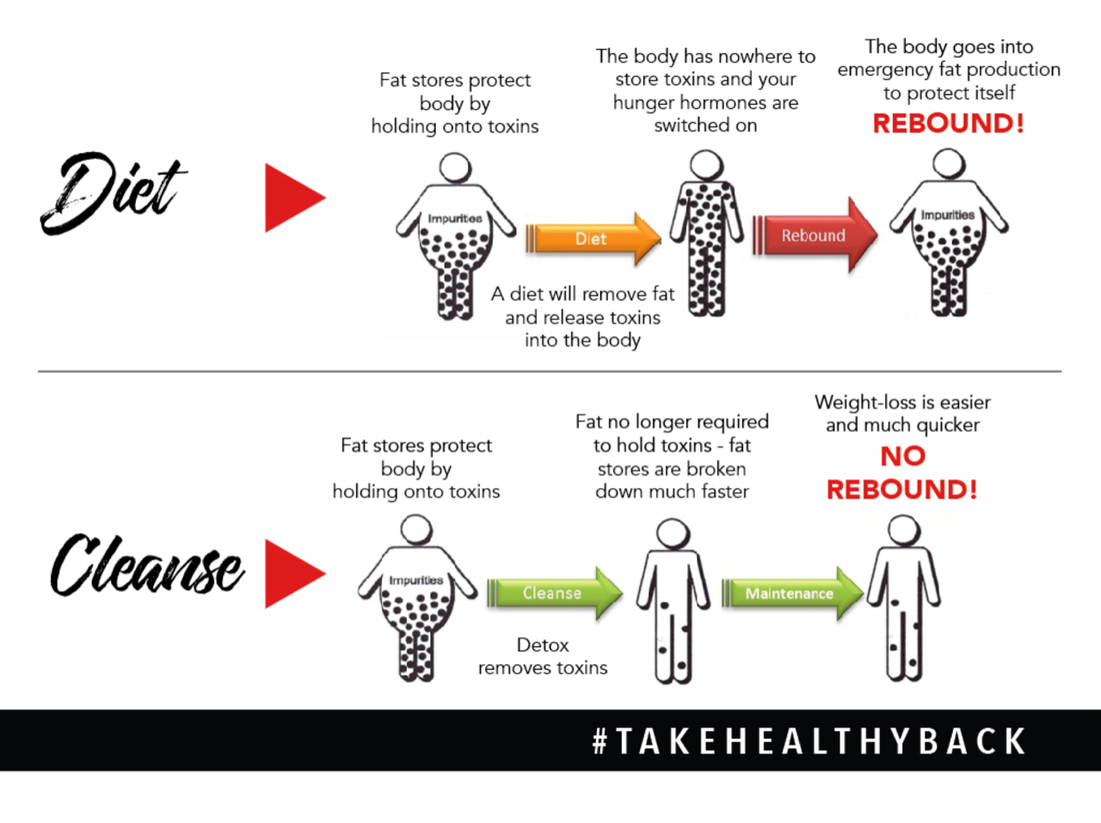

Notes:
SCRIPT IDEA: Let’s talk about an important topic for many people - maintaining a healthy weight-because we know that excess fat contributes to over 20 different diseases. Remember the toxins we talked about earlier? Well, our bodies can’t handle the onslaught of toxins, so it protects our organs by trapping the toxins in fat cells. The good news is this keeps the toxins from roaming and causing havoc in our bodies. The bad news is the fat cells expand and can cause weight issues.
When you burn fat in the wrong way without proper nutrition or with over-exercising, the toxins are re-released into the bloodstream…which stresses the body…so your body (very smartly) goes into fat production to once again enrobe the toxins, protecting vital organs, and the fat returns. Its a vicious cycle.
(CLICK) There is a better way. The safe and healthy way to lose weight is to allow your body to cleanse itself by removing the toxic load, and adding CLEAN eating, especially fruits and vegetables. Now you are shedding fat, and assisting your liver so it can do its job and cleanse the toxins. Weight loss is easier, quicker and leads to move permanent weight loss.

Slide 23
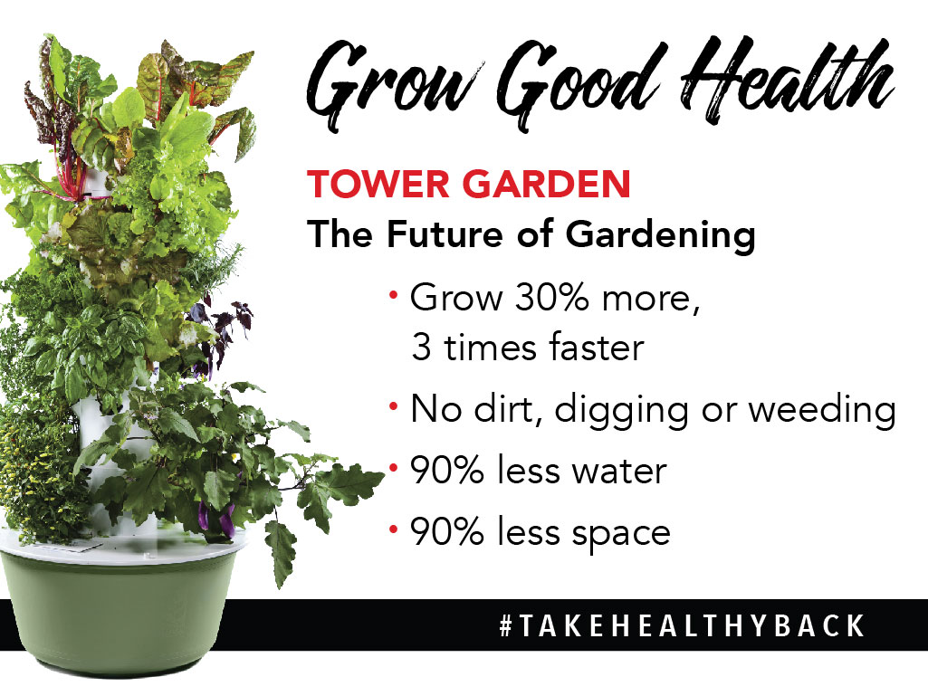
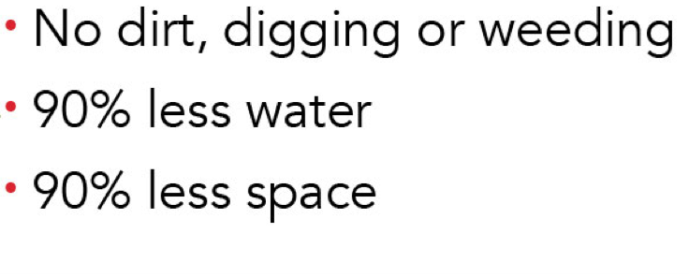
Notes:
(OPTIONAL SLIDE)
SCRIPT IDEA: We always want to encourage you to eat more fruits and vegetables – sometimes it is helpful to grow your own. We use the Tower Garden to have more control over how our food is grown, and for the convenience of having a farmers market on our porch or in our house! This excites adults and children alike. We love to add greens to our Juice Plus shakes too!
1. Get back with the person who invited you to learn more
2. Explain and show pictures of your Tower - The Tower Garden is a vertical aeroponic growing system that allows you to grow your own fruits and vegetables on your porch, patio, or even inside with grow lights. In a study, the TG actually had a 30% higher yield of produce and the nutritional equivalence to fruits and vegetables grown in the best soil. This makes growing fun and easy and is an amazing fit for the growing movements of Farm to Table, Eating local and organic. Schools are jumping on board and we even have a school curriculum for the TG!
INSERT YOUR OWN TOWER GARDEN PICTURES

Slide 24





Free Cookbook
Free Kid’s Program
Facebook Support Groups
Live and Online Educational Events
Visit www.HealthyLivingRevolution.com
Notes:
SCRIPT IDEA: We invite you to be part of our Healthy Living Community called the Healthy Living Revolution. We have some amazing resources for you! We have cookbooks, children’s resources, Facebook groups for encouragement and educational events to help you continue making simple changes. You can access them by going on our website listed and also by joining our FB group.
Get with the person who invited you to take advantage of all we have to offer.

Slide 25
UPCOMING EVENTS
Notes:
INSERT FLYERS FOR UPCOMING EVENTS (in your local area, on Zoom, Facebook, the monthly HealthyLivingRevolution.com/LIVE event) Promote your upcoming events!
“We would love to invite you to join us ________. Every month the Healthy Living Revolution features a different medical speaker and whoever invited you, can send you the link.”

Slide 26

Notes:
SCRIPT IDEA: So we invite you to join us ☺ (A, B, C close)
Some of you may be inspired to eat more F & V and that’s great
Some of you also want to make One Simple Change and add JP+ to your diet or jumpstart your health with the Shred10
Maybe you’ve been sitting here thinking about how you can share this information with your best friend, parents or siblings and if that’s you we would love to tell you more about your options to share this with others.
Close: PLEASE GET BACK WITH THE PERSON WHO INVITED YOU to learn more about anything we discussed.
(Optional – hand out order forms and review with guests)
We are so happy to help you and thank you so much for spending this time with us!

