Slide 1

Notes:
Hello everyone! My name is _______. Welcome and we’re so glad you’re joining us! For the first few minutes, we are going to talk about health and how we as a community are offering solutions and how lives have been changed through our initiatives. After that, we will share with you about a wonderful company that is inspiring healthy living around the world. Thank you for joining us!

Slide 2




Notes:
_______ and I, along with thousands of others around the world are part of a movement called the Healthy Living Revolution, where we are offering people simple solutions to take their health back. We have a website that offers free cookbooks, educational webinars, a kid’s program, Juice Plus+ and the Shred10.

Slide 3


Notes:
We all know fruits and vegetables are good for us, but we don’t know WHY or HOW MANY we need to be eating everyday. Our message is to help people understand they’re supposed to eat 7-13 servings every day. Almost no one does that, and definitely not the variety we need. Juice Plus+® is a nutritional breakthrough that BRIDGES THE GAP!

Slide 4
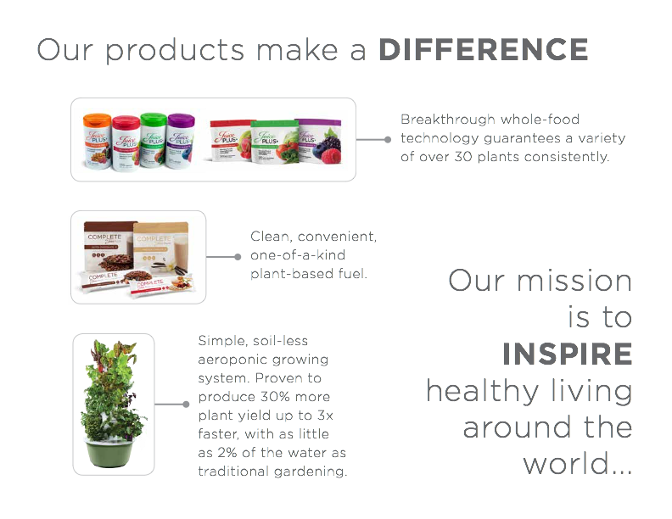
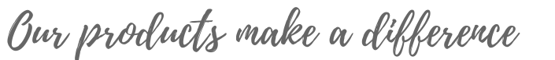
Notes:
Our products fill in this fruit and vegetable gap! Juice Plus+ is the simplest way to add nutrition from more than 50 fruits and vegetables. It’s concentrated nutrition. We have…
1. The fruit, vegetable and berry capsules or chewables.
2. The plant based omega blend capsules.
3. The Complete shake and bars.
4. The Tower Garden.
(Option: Hold up Capsules in one hand and Chewables in the other hand, so guests can see them.)

Slide 5

Notes:
We also have a program called the Shred10™ for people looking for lifestyle guidelines.

Slide 6

It’s food, not a vitamin.
2. It’s NSF Certified®
3. It’s the most researched in the world.
Notes:
There are a lot of nutritional products out there but Juice Plus+ is unique in 3 ways:
1. It’s food, not a vitamin. (show food label) This is a nutrition label, not a vitamin supplement label. It’s the same label you’ll see on a bag of frozen broccoli in the grocery store. The government considers this food.
2. NSF, a private company certifies JP+ products to be sure that what is on the label is in the product and they stringently test for pesticides, mold, bacteria, stimulants. etc. There is no warning label on JP+ —safe for people of all ages, pregnant & nursing mothers, children, elderly, and even professional athletes.
3. And JP+ is THE most thoroughly researched nutritional product in the world with nearly 40 published studies.

Slide 7


Notes:
JP+ is set apart from all other nutritional products because of the original, clinical research that has taken place all over the world for over 20 years. Well known research institutions have studied what happens in people’s bodies when they consume Juice Plus+. These are gold standard – double blind, placebo controlled, randomized so very credible research that has been published in peer reviewed medical journals.

Slide 8




Notes:
The Global Children’s Health Study is a way for children ages 4-college age to receive their JP+ free for up to 4 years with an adult sponsor. The results that these families are experiencing is a true testament that JP+ is inspiring healthy living around the world.

Slide 9

Notes:
INSERT PHOTOS OF STORY TELLERS
Juice Plus+ Product Stories
Host shares his/her product story and then says, “____________, please share with us your Juice Plus+ experience.”
How to write your product story:
_______ years/months/days ago I was ____________ (describe BEFORE Juice Plus+). Then I learned about a simple change I could make to flood my body with 30 fruits and vegetables every day. I can’t believe the difference it has made in my health. Now I’m ______________ (describe AFTER Juice Plus+) I’m so thankful I learned about Juice Plus+!

Slide 10
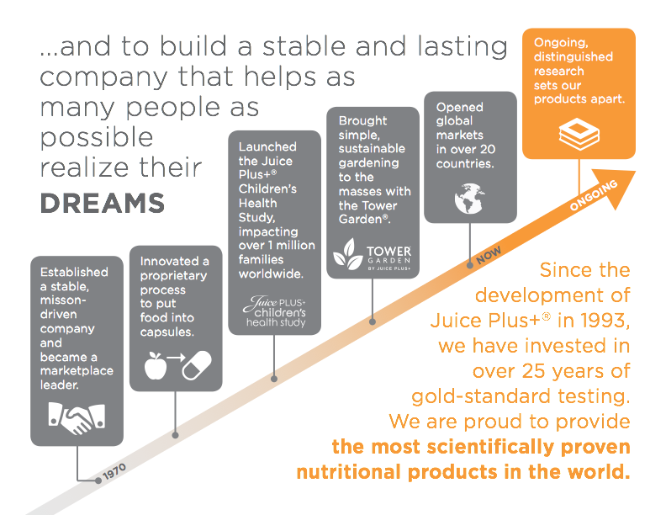
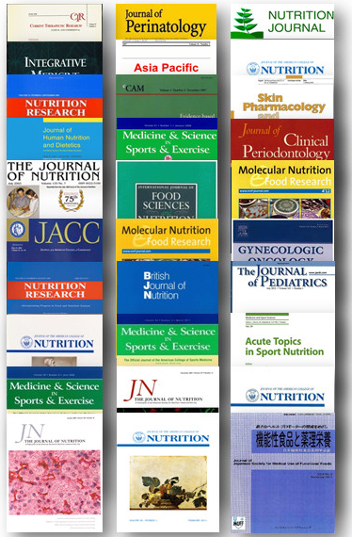








children’s
health study
COMPANY
Notes:
Let’s talk now about the company behind Juice Plus+®. JAY MARTIN founded the Juice Plus+ company almost 50 years ago and his vision is to build a stable and lasting company that helps as many people as possible realize their dreams. This is why JP+ is sold the way it is - person to person to help us realize our dreams.
It is a privately held and debt free company with 14 billion in sales. The company is on track for $1 billion per year by 2020.
It is a product driven company. 80% of JP+® is purchased by customers who have no affiliation with the company.
Over the years the company has had many break-through products and programs - like JP+, the Children’s Health Study, the Tower Garden.
There are no territorial restrictions and the Juice Plus+® Company is in over 20 countries around the world!
JP+ is the largest selling nutritional product in a capsule in the world. The research is truly what sets Juice Plus+ apart!

Slide 11




Notes:
The Juice Plus+® Company has found so many ways to give back.
Juice Plus is the title sponsor for the St. Jude’s Marathon each year—in 2016 $10 million was raised for the children’s hospital.
The company is donating over 4,000 Tower Gardens to every Boys and Girls Club in North America.
They even created a technical institute for students and 100% of the graduates have been placed in jobs.
The company is donating 10 million Complete meals through Volunteers of America.

Slide 12
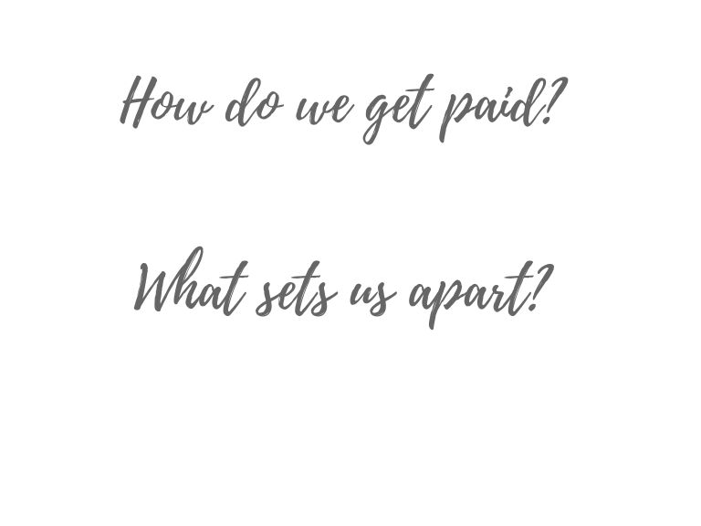

$50 per year
Business Websites
Company Support
No Inventory
Commissions Permanent
Family Insurance Package
No Quotas or Minimums
Part-time or Full-time
Consumable Products
Residual Income
Notes:
So how does it work?
It’s called a virtual franchise and it’s $50 per year to own the business.
With your own Virtual Office and personal juiceplus.com website - you can run your business from any device… anytime, anywhere.
The company does so much for us - they manufacture Juice Plus+®, deliver it, bills & collects from customers, and pays us by direct deposit each month. We just share by word of mouth, and the company does the rest.
There is no inventory to keep; the only Juice Plus+® we touch is our own.
All commission levels are permanent.
At the top positions, families are eligible for benefits including: medical, dental, vision, life, long-term care, disability, chiropractic, prescription, college tuition assistance, holiday bonus and a monthly expense allowance.
There are no quotas or minimums to meet. People can share a little or a lot with freedom to choose their own individual pace.
This can be extra, part-time income, or full-time income which can create long-term wealth and retirement.
JP+ is a consumable product that creates residual income indefinitely. This is income that continues as long as your customers and your team’s customers continue eating Juice Plus. Let’s talk about residual income.

Slide 13
Retail Profit
2. Commissions
3. Bonuses
Notes:
Money is made in 3 ways:
1. Retail Profit - which is the difference between the customer cost of JP+ and the wholesale cost.
2. Commissions - There are 3 commission levels 6%, 14% and 22% and the company has a program to help you reach the 22% level in your first six months.
3. One-time and Residual Bonuses - You’ll receive one-time bonuses all along the way as you reach the next level and residual bonuses as you build a team. Building a team creates exponential income. It’s like a real estate broker who supports and trains a team of realtors. The broker earns a portion of what each realtor does. That’s the same in our business. We receive a residual bonus because we have trained and supported our team.

Slide 14


Notes:
We all have relationships with people who need to know more about this simple solution. How we share is just like how you would share a good movie or book with someone - person to person, friend to friend. We then give a follow up resource to educate. We get customers and they have a great experience with our help. They then start telling others and thats how you end up with team members. It happens everyday! The company and your support team help provide tools and resources to grow your customer base and team so you can share and expand your influence. Through it all we learn so much that is applicable to all parts of life.
Juice Plus+ Business Stories
• Host shares his/her business story and then says, “____________, please share your experience after joining this company and mission.”
How to write your business story:
Experience: "I was having such a great JP+ experience” or “Juice Plus+ made so much sense to me”
Share: "I started sharing JP+ with others"
Join: "I learned more about the JP+ Company and wanted to join their mission of Inspiring Healthy Living Around the World." (Then move to the P.L.O.T outline below)
PAIN: I used to/I am/I work as ____________. I enjoy it because _______.
LESSON: The problem is/was _________. I realized that __________.
OPPORTUNITY: Then, I found JP+ and I got healthier and decided to share JP+ with others and help them get healthier too! And I’m having fun doing it! I love ________.
TRIUMPH: Now I’m celebrating __________. And I love that I get to help others realize get healthier and realize their dreams too!

Slide 15
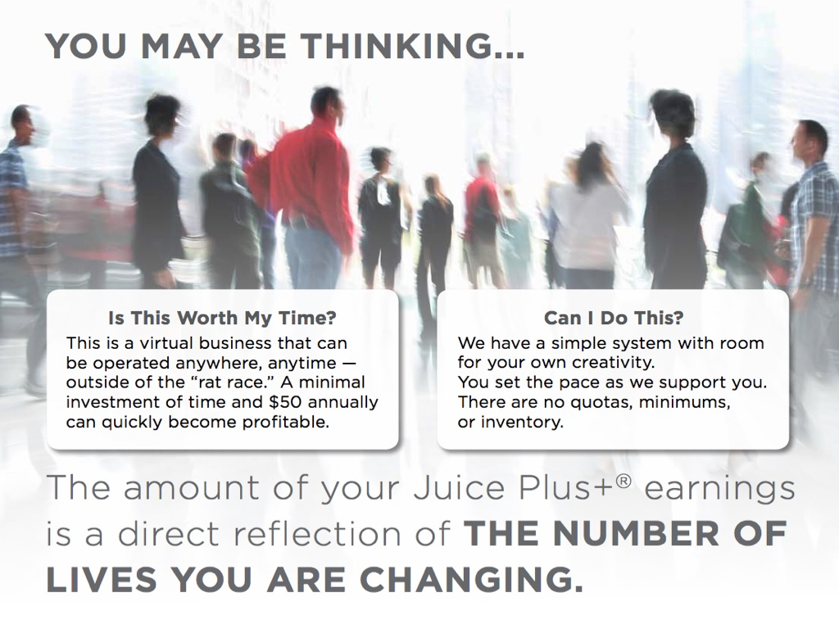


Notes:
You might be asking yourself, is this something I can learn or add to my already busy schedule? Those are normal questions! We have found anyone can do this, even the busiest people! There’s a simple system in place and you can set your own pace. Just like JP+ is the way to bridge the gap with nutrition, the Virtual Franchise is a way to bridge the gap with finances. I love knowing that my Juice Plus+ paycheck is a direct reflection of the people I have helped!

Slide 16

Notes:
So we invite you to join us (A, B, C close)
A. Perhaps you listened and thought of people who may be interested in sharing this with us.
B. Perhaps some of you thought this would be a fit for YOU and are ready to join our mission, make some extra income for a car payment, family vacation or to pay off debt.
C. And there may be some of you who want to take this even further and create full time income with benefits.
Wherever you are in those scenarios, you are all welcome to be part of our community and come alongside us to share a little or a lot and impact lives. We ask you to please get back with the person who invited you so you can discuss whats next!
We are so happy to help you and thank you so much for spending this time with us!

